Slide 1
AWS - TRAINING
IAM
Identity Management Console
GLOBAL SERVICE

Slide 2
Overview
It is a service that helps you to securely control access to AWS resources.
In AWS, We cannot allow everyone to allow anything .Hence,IAM is the solution.
Allows you to control users accessing your account as well as limiting their role as well.
You as a user can only perform some task in AWS console if you are authenticated as root user or IAM user or by assuming an IAM role.
If we are using AWS programmatically, Use SDK or CLI to cryptographically sign your request using your credentials.

Slide 3
IAM groups & Users
An IAM group is a collection of IAM users.
Group allows us to specify permissions for multiple users at a time.
Ex: We can have a group name IAMadmins anf give them admin permissions.
An IAM user is associated with one person or application.
Once a user is created it can be assigned with IAM role.
A user can belong to multiple group.

Slide 4
Least Privilege Principle
In AWS, We cannot allow everyone to allow anything .Hence,IAM is the solution.
It will be a risk to security and costing for the organization .
Hence,Least Privilege Principle says don’t give user more persmissions than a user needs.

Slide 5
Policy
In AWS IAM (Identity and Access Management), a policy is a JSON document that defines permissions and access control rules for AWS resources.
Policies are used to determine what actions users, groups, roles, and other AWS identities are allowed or denied when interacting with AWS services and resources.

Slide 6
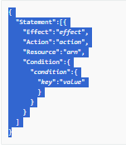
IAM POLICY STRUCTURE
There are various elements that make up a statement:
Effect: The effect can be Allow or Deny. By default, users don't have permission to use resources
Action: The action is the specific API action for which you are granting or denying permission.
Resource: The resource that's affected by the action.
Condition: Conditions are optional. They can be used to control when your policy is in effect.

Slide 7
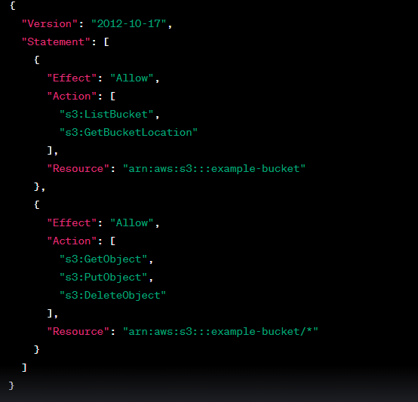
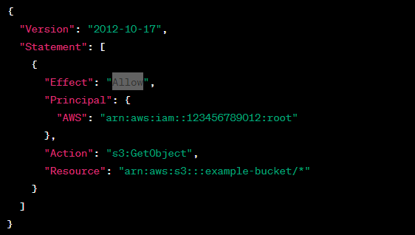
Resource Based VS IAM Based
Resource Based
IAM Based

Slide 8
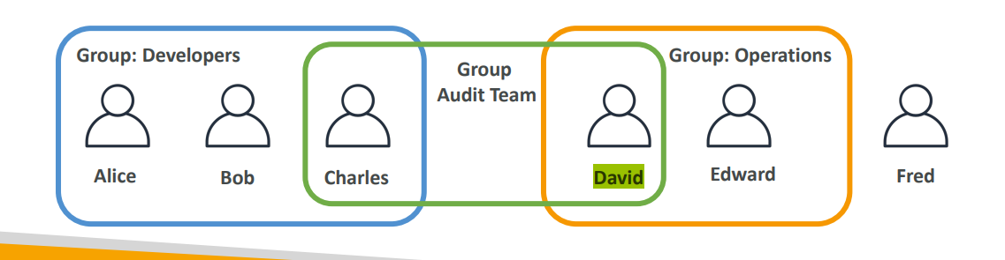
IAM LAB:

Slide 9
Security
Once users and group created , we need to protect them from being compromised.
Ways to ensure security:
1. Passwords
2. MFA :
→ Virtual MFA device = Google authenticator,Authy
→ Universal 2nd Factor Security Key = Yubikey by yubico 3rd party

Slide 10
Roles
When you create a role, you create two policies:
1. A role trust policy that specifies who can assume the role.
2. A permissions policy that specifies what can be done with the role.

